Slide 1
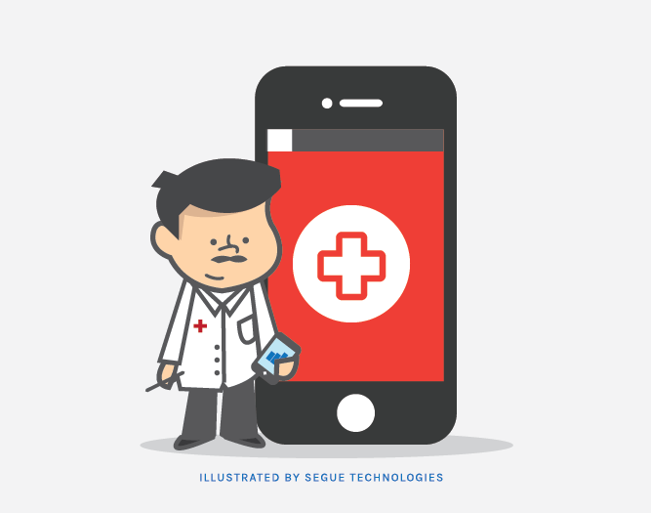
Urgent Healthcare Solutions
Group 17:
Anay Dutta
Anisha Vijayan
Saloni Kataria
Sravya Chouta

Slide 2
CONTENTS
01
Introduction
02
Project Overview
03
Project Scope
04
Project Plan
05
Solution, Challenges & Deliverables
06
Next Steps
07
Conclusion

Slide 3
Introduction
Iyka, an award-winning data management company, simplifies technology processes for clients globally with innovative products and services. They specialize in the USA, South Asia, and Europe in the following areas:
Next-generation data analytics
IT services
Software development
The Iyka value proposition includes:
Empowering end-users with a highly innovative software platform
Being a strategic supplier of data management services
Providing risk management through people, process, and tools
Iyka is committed to providing the clients with cutting-edge solutions that meet their needs and exceed their expectations.

Slide 4
Project Overview
Purpose:
App that recommends the nearest and lowest wait time urgent care facilities based on 3 important factors: distance, wait time & commute time
“time-to-care” metric: wait time + commute time
Multi-fold Business Values:
Create a competitive advantage in the market by providing an efficient solution.
App improves operational efficiency by reducing the workload on medical staff.
App provides valuable insights into customer preferences and behavior.
Customers view wait times of facilities and pick one that meets their requirements, reducing workload from phone calls and inquiries.

Slide 5
Project Scope
Justification: Customers view wait times of facilities and pick one that meets their requirements.
Objective: Build an app (.apk file) to recommend relevant ER facilities.
Deliverables: .apk file, source code, user manual, technical documentation
Acceptance Criteria: App renders the top 3 facilities within seconds. App must be compatible with latest mobile devices.
Assumptions: Real-time data is always available to provide accurate recommendations
Project Constraints: Cost, time, third-party data providers

Slide 6
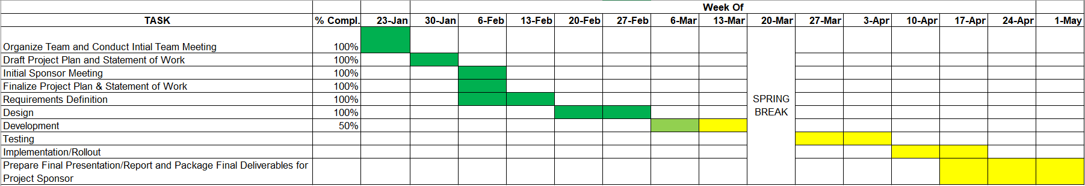
Original Project Plan

Slide 7
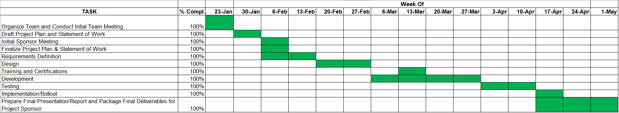
Final Project Plan
Training & Certifications not considered in Original Plan; had to incorporate it
Extension of Development by a week - delayed Incorta Certification - took different approach
Adjusted with the Implementation and Rollout - tasks already done in Test phase

Slide 8
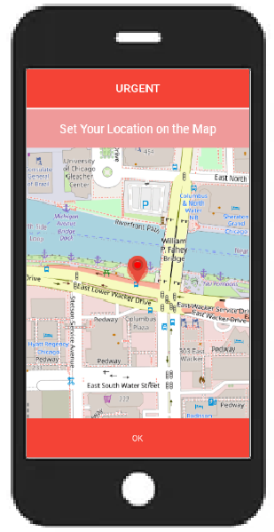
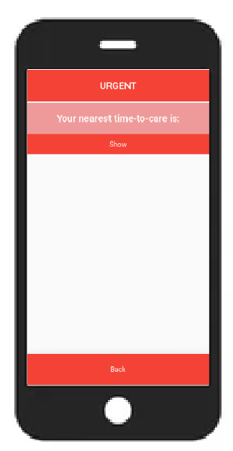
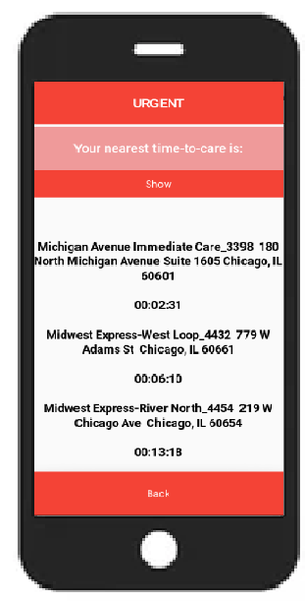
Solution: URGENT App
App named “Urgent” which would produce the list of nearest and lowest wait time urgent care facilities so that users can feel a sense of ease of transportation during an emergency.

Slide 9
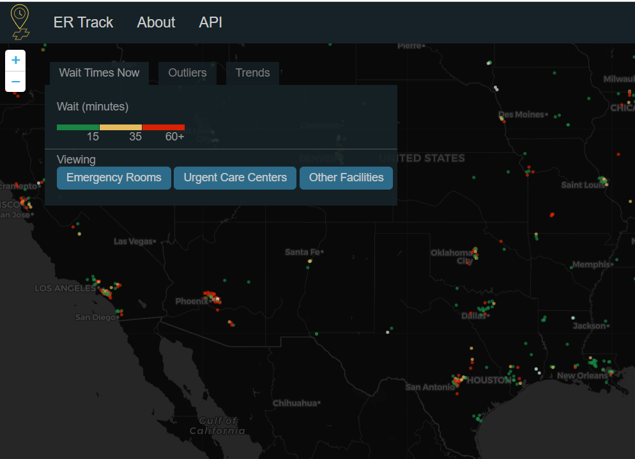
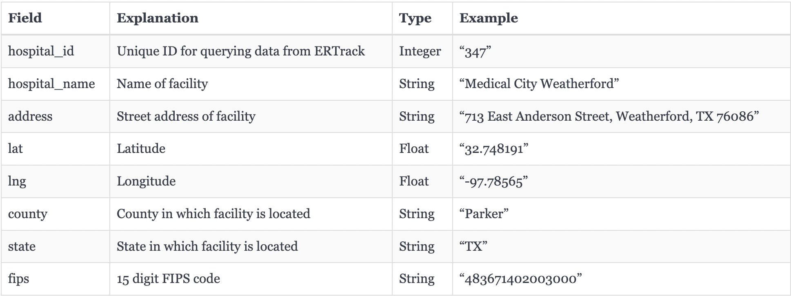
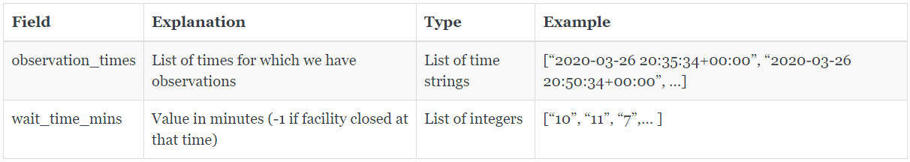
Data Sources - I
ERTrack.net API : https://ertrack.net/api/
To see all hospitals: https://ertrack.net/api/hospitals/
To get the wait time history of a single facility: https://ertrack.net/api/hospital/{hospital_id}/history/
Notes:
We have used the ERTrack.net websites data as our main source of data. We tried to look for data sources pertaining to patients and their services as well as insurance related data to be displayed in the app, but could not find appropriate sources. ERTrack.net gives the wait time for each specific urgent cares and facilities.

Slide 10
Data Sources - II
Open Source Routing Machine (OSRM)
C++ implementation of a high-performance routing engine for shortest paths in road networks
Flexible import of OpenStreetMap data
Supports car, bicycle, walk modes
Used to estimate the real time traffic
Time taken to reach each facility from user’s location
API: http://router.project-osrm.org/route/v1/car/{lon_1},{lat_1};{lon_2},{lat_2}?overview=false

Slide 11
Data Sources - III
Geopy
Python client for several popular geocoding web services
makes it easy for Python developers to locate the coordinates of addresses, cities, countries, and landmarks
Nominatim (geolocator = Nominatim(user_agent="Geolocation"))
App detects location of user using GPS in mobile device
Helps to find the address corresponding to a set of coordinates
Geodesic (geodesic(lat_lng_user, lat_lng_hosp).miles)
Used for measuring distance
Can calculate geodesic distance between two points using the geodesic distance or the great-circle distance
Geodesic distance: shortest distance on the surface of an ellipsoidal model of the earth
Calculate the distance between user’s location and all facilities in the nearby region; to filter out top 8 facilities based on distance

Slide 12
Challenges & Solutions
Challenges | Solutions
Discrepancies in the dataset (ERTrack.net) Missing values for some facilities Server Error from the ERTrack.net for few facilities | Used KNN Imputer to impute the missing wait time values
Current wait time available; need to predict the next wait time | Examined multiple techniques like LSTM, ARIMA and Moving Average models to predict the next wait time at a particular facility
Faster prediction algorithm to get quick turnaround in the app | Moving Average model adapted due to its quick turnaround time
Look for facilities in nearby states in case patient lives in the borderline region | Based on the current location of the user, facilities were fetched from current and nearby states
Consider closing/unavailability of the facilities | From historical data of wait times, estimated the closing and unavailability of each facilities
Don’t want patients to travel long distances | Adopted TOPSIS algorithm to rank the best solution
Optimization of the machine learning part | Tried to implement asyncio for optimizing the machine learning algorithm
Limited skill set for creation of Mobile App | Learned and implemented App using Kivy & Buildozer library
Notes:
TOPSIS : Technique for Order Preference by Similarity to Ideal Solution

Slide 13
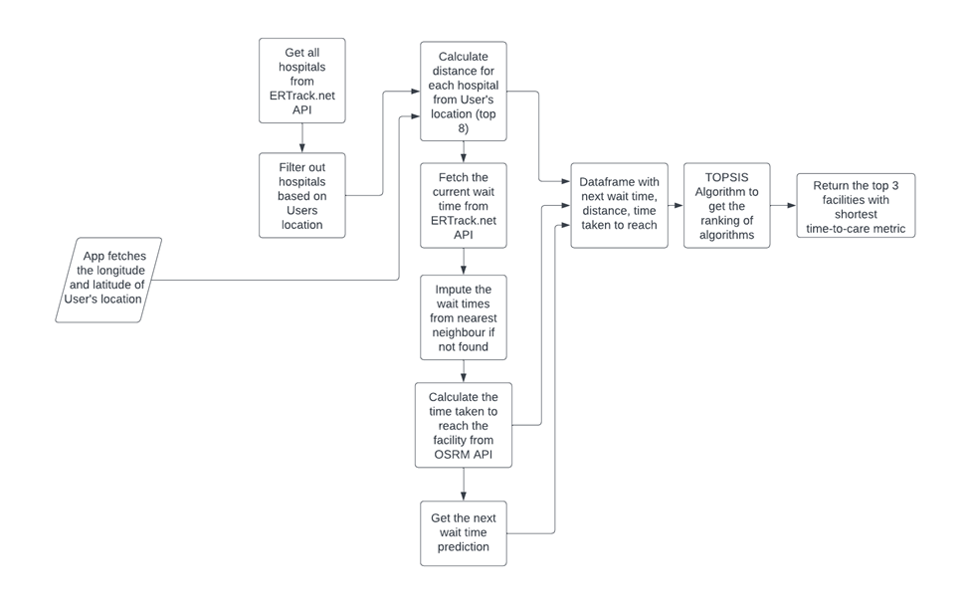
Technical Design

Slide 14
Deliverables
APK file
Source code for the App
Technical Design Specification Document
Test Cases
User Manual for the App
Incorta Certified:
Anay Dutta (Incorta 5 Essentials for Business Analysts)
Anisha Vijayan (Incorta 5 Essentials for Business Analysts,
Incorta 5 Foundations for Developers,
Incorta 5 Fundamentals for Administrators )

Slide 15
Next Steps
Phase II: Optimization of the Application
Phase II: Continued testing and development of the APK file on device
Enhance the visual aspect of the application
Add more aspects like
Links to the facilities,
Booking an Uber from the App,
Insurances covered by each facility,
Services covered by each facility

Slide 16
Conclusion
No existing solution for finding wait times at urgent care facilities during emergency situations
Incorporated multiple data sources like ERTrack.net, OSRM, Geopy to build a solution based on the hospital waiting time, distance, and estimated time to arrival
Built a Mobile Application ‘URGENT’ which gives out nearest and lowest wait time facilities based on users location
Up-and-coming: Continued enhancements and testing of the application
Fixing APK file
Optimization of the Application
Visual Enhancements

Slide 17
Thanks

